Slide 1

Marketing Analysis for CoolTShirts Course: Codecademy SQL from Scratch Presented by: Olivia Earenfight Date: August 12, 2018

Slide 2
Table of Contents
Background:
Introduction
The Schema
Company Background
Data Analysis:
First Touches
Last Touches
Purchases
Purchases By Campaign
Results:
The Typical User Journey
Campaign Budgets
Understanding the Approach
Dictionary

Slide 3

Introduction
Research Question
CoolTShirts (CTS) has recently embarked on several marketing campaigns to increase traffic on their website and to increase sales. They want to know what the typical user journey is in order to discern which of their campaigns will help them towards their goal.
The Solution
I will use first and last touch attribution to determine which of the campaigns CoolTShirts tested produces the highest number of purchases.
*Image from Google stock photos

Slide 4



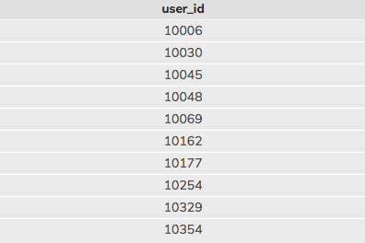
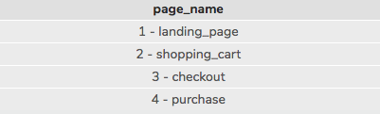
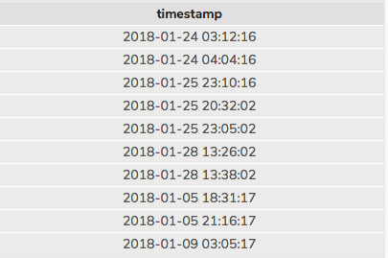
The Schema
user_id (integer)
Each visitor to the website is given a unique id number stored in the user_id column.
page_name (text)
This tells us exactly which page on CoolTShirts’ website the user visited.
timestamp (text)
This tells us what date and time the user visited the website.

Slide 5


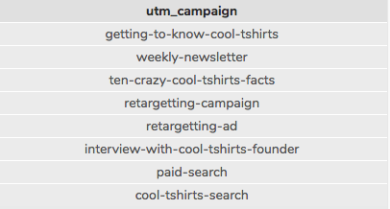
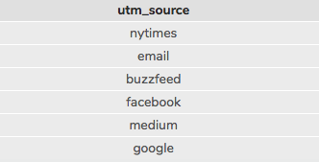
The Schema continued
utm_campaign (text)
This tells us which marketing campaign is associated with their journey. For example, did they see something about CoolTShirts in theCoolTShirts’ weekly-newsletter?
utm_source (text)
This tells us where the user was before they clicked on the CoolTShirts website. For example, whether the user clicked on the website from Google, or from their email.

Slide 6






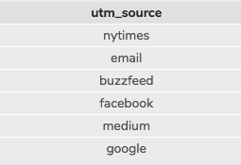
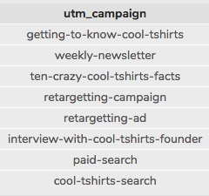
Company Background: Campaigns vs. Sources
utm_campaign vs. utm_source
The utm_campaign column (left) refers to which campaign is attributed to each time a user visits the CoolTShirts website. The utm_source (right) refers to which website the campaign was placed on and which ultimately led to a user reaching the CoolTShirts website. For example, a user could have been on the New York Times website (source) and seen a video ad for “interview-with-cool-tshirts-founder” (campaign).

Slide 7

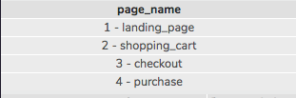
Company Background: Pages on CoolTShirts Website
CoolTShirts has four pages on their website; 1-landing_page, 2-shopping_cart, 3-checkout, and 4-purchase. The page_name column in the page_visits table tells us what page is associated with each user’s visit to the CoolTShirts website. As we will see later, this will be especially important in discerning which campaigns to invest in.

Slide 8
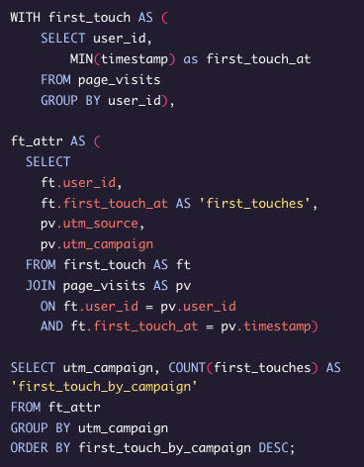
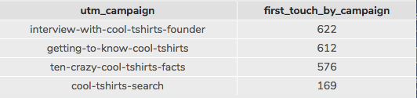
User Journey: First-Touches
The table (above) resulting from this query (left) demonstrates the number of first touches that can be attributed to each campaign. Broken down, the number in each row of the column “first_touch_by_campaign” represents how many unique users were brought to the CoolTshirts website from each of the campaigns run by CoolTShirts.

Slide 9
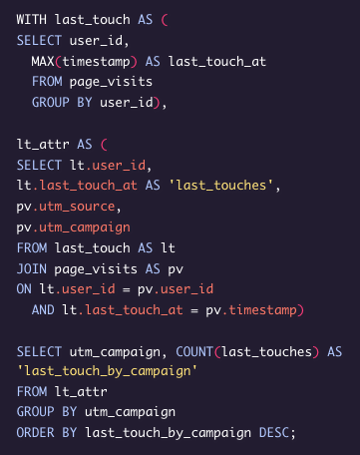
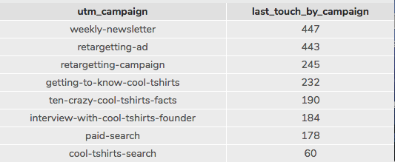
User Journey: Last-Touches
This table, in contrast to the previous table, represents the results from the query (left), which pulls the number of last touches attributed to each campaign. Essentially, this demonstrates the last time each user visited the CoolTShirts website, and specifically, which campaign led the user to the site at this specific time.

Slide 10



Purchases
This query demonstrates the total number of purchases made on the CoolTShirts website.
*Image from Google stock photos

Slide 11
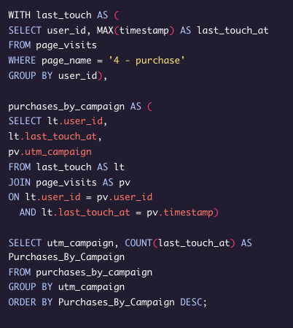
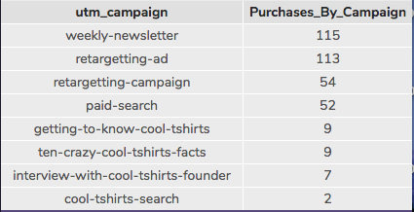
Purchases by Campaign
The “Purchases_By_Campaign” column helps us understand one of the most essential results of this analysis, the number of purchases made attributed to each unique campaign. This will help us determine where CoolTShirts should invest their budget.

Slide 12
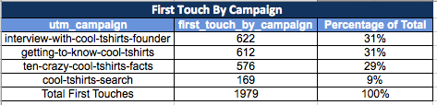
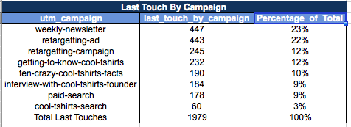
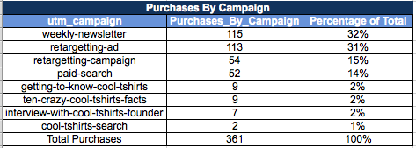
The Typical User Journey
In summary, most users first visit the website via the “interview-with-cool-tshirts-founder” campaign at 31%, closely followed by the getting-to-know-cool-tshirts campaign” at 31%. The “weekly-newsletter”, “retargeting-ad” , and “retargeting-campaign” campaigns bring in 78% of purchases. As seen in the table “Purchases By Campaign”, only 4% of users make purchases via the “interview-with-cool-tshirts-founder” and “getting-to-know-cool-thirts”. Therefore, these two campaigns alone are not sufficient enough to increase purchases.

Slide 13
Campaign Budget
Two prong approach to increasing purchases on the CoolTShirts Website.
Step One: Bring in more potential customers
Invest in “interview-with-cool-tshirts-founder”
Invest in “getting-to-know-cool-tshirts”
Step Two: Bring users back to the website to finalize purchases
Invest in “weekly-newsletter”
Invest in “retargetting-ad”
Invest in “retargeting-campaign”

Slide 14
Understanding the Approach
I recommend investing in the “interview-with-cool-tshirts-founder” campaign and the “getting-to-know-cool-tshirts” campaign as they brought in the largest percentage of users among the campaigns to the website with a first-touch attribution rate of 62% .
Additionally, investment in the “weekly-newsletter”, the “retargeting-ad”, and the “retargeting campaign” are recommended in order to increase purchase rates. This recommendation is based on the fact that combined, they brought in 78% of purchases.
Investing in this combination of campaigns will ensure that higher numbers of users are accessing the website, and higher numbers of those who go to CoolTshirts’ website are making purchases.

Slide 15
Dictionary
Text: A string of characters within a set of parentheses.
Integer: A whole number.
Float: A number with decimal points.
Schema: a collection of data that describes the relationships in a database.
First touch attribution: the first time a user_id accesses a website.
Last touch attribution: the last time a user_id accesses a website.

